Slide 1
Cahn-Hilliard Model
Wentao Gong
Sep,06,2023

Slide 2
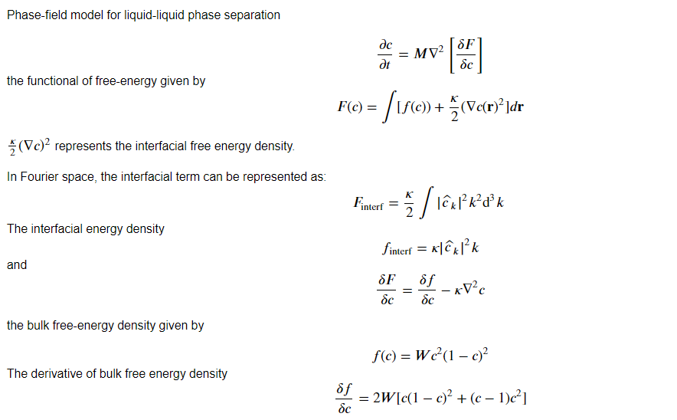
Introduction: Theory and Concepts

Slide 3
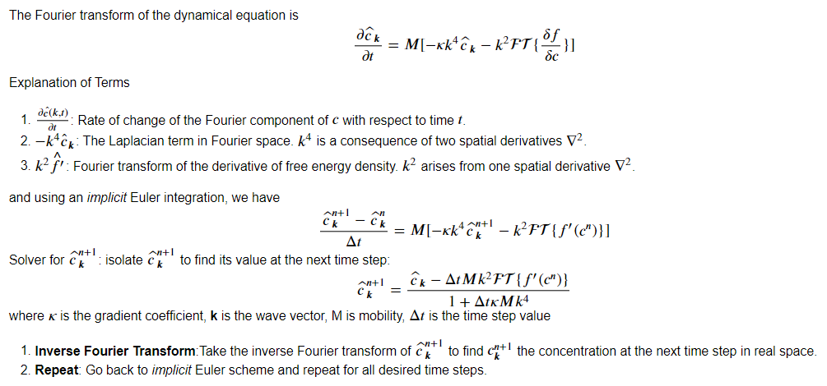
Cahn-Hilliard equation wit Pseudo-spectral method

Slide 4
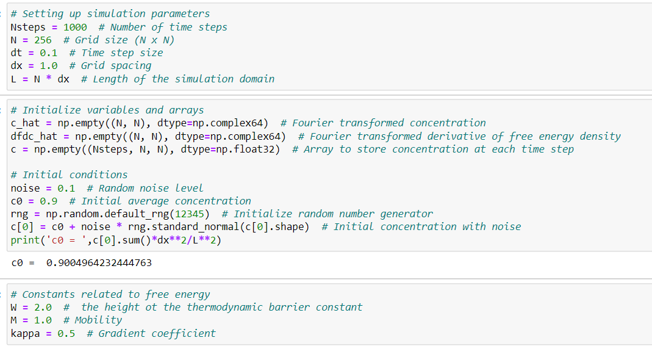
Case studies: initial conditions and parameters

Slide 5
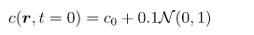
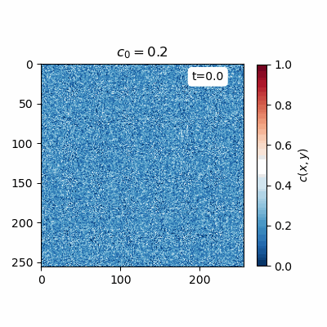
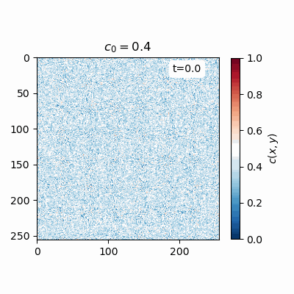
Case studies: results
M=1.0, W=2.0, dx=1.0, dt=0.1

Slide 6
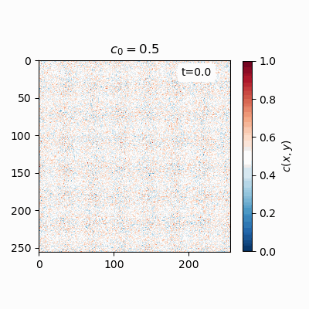
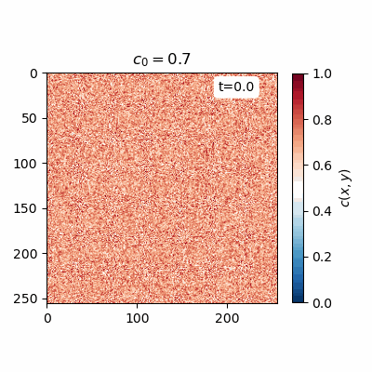
Case studies: results
M=1.0, W=2.0, dx=1.0, dt=0.1

Slide 7
Future work
Modify the classical Cahn-Hilliard model by supplementing the equilibrium Ginzburg-Landau dynamics with particle-number-conserving currents
Reference: Saha, S., Agudo-Canalejo, J., & Golestanian, R. (2020). Scalar active mixtures: The nonreciprocal Cahn-Hilliard model. Physical Review X, 10(4), 041009.

